Slide 1
7 Algorithm design and problem-solving
Algorithmic thinking

Slide 2



Algorithmic thinking
Algorithmic thinking is a way of getting to a solution by identifying the individual steps required.
By creating a set of rules, an algorithm – when followed precisely – will lead to an answer. For example, in school, we all learn algorithms for doing multiplication.
If a human (or a computer) follows these rules precisely, the answer to any multiplication problem can be found.

Slide 3
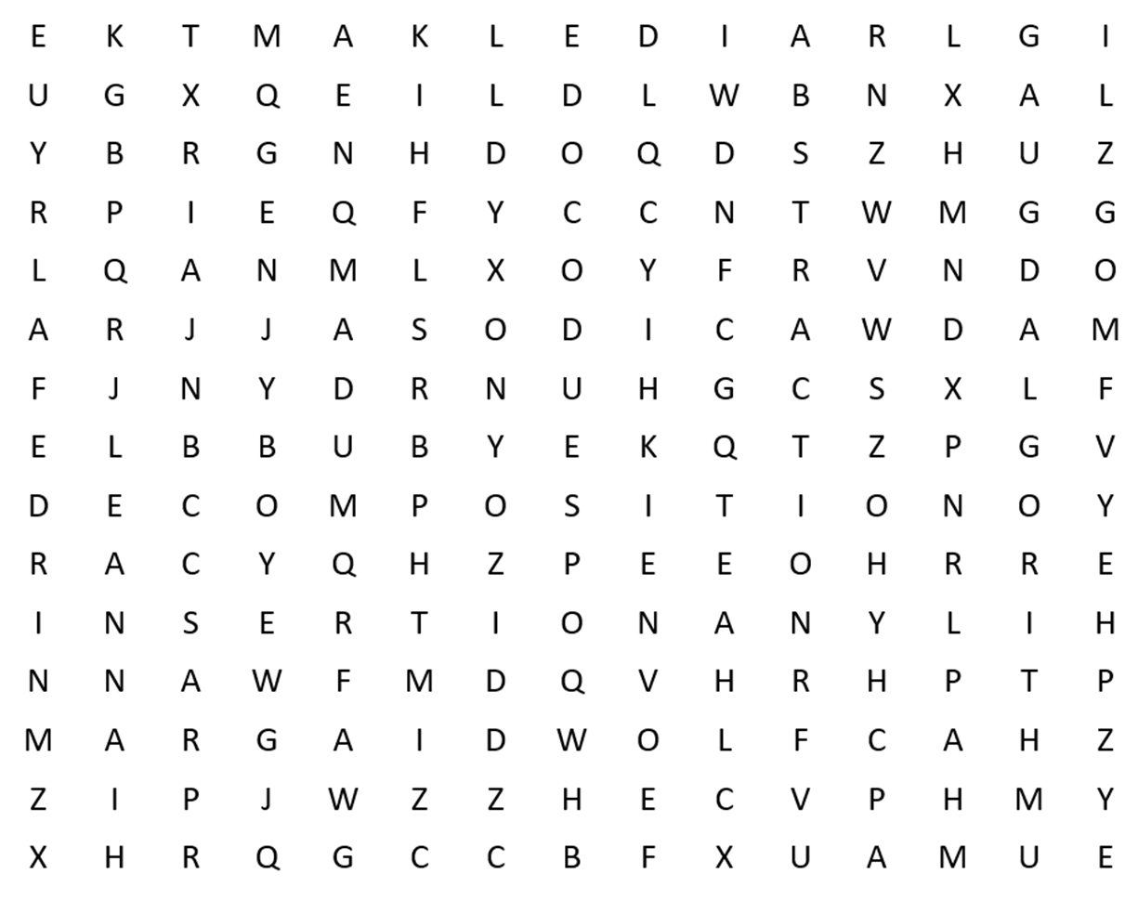
Algorithmic thinking
Word search for key terms: Algorithm
Abstraction
Algorithm
Binary search
Bubble
Decomposition
Flow diagram
Insertion
Linear
Merge
Pseudocode

Slide 4
Algorithmic thinking
Word search for key terms: Algorithm
Abstraction
Algorithm
Binary search
Bubble
Decomposition
Flow diagram
Insertion
Linear
Merge
Pseudocode
Find instances of the letter A.

Slide 5
Algorithmic thinking
Word search for key terms: Algorithm
Abstraction
Algorithm
Binary search
Bubble
Decomposition
Flow diagram
Insertion
Linear
Merge
Pseudocode
Find instances of the letter A.
Check surrounding letters – are any of these the next letter we need?

Slide 6
Algorithmic thinking
Word search for key terms: Algorithm
Abstraction
Algorithm
Binary search
Bubble
Decomposition
Flow diagram
Insertion
Linear
Merge
Pseudocode
Randomly trying to find the letter A is not a very logical thing for a program to do.
We would be better off starting from the top-left and working logically until we find the letter A.

Slide 7
Algorithmic thinking
Word search for key terms: Algorithm
Abstraction
Algorithm
Binary search
Bubble
Decomposition
Flow diagram
Insertion
Linear
Merge
Pseudocode
At that point, we could check the surrounding letters to see if any of them are the next letter we need.

Slide 8
Algorithmic thinking
Word search for key terms: Algorithm
Abstraction
Algorithm
Binary search
Bubble
Decomposition
Flow diagram
Insertion
Linear
Merge
Pseudocode
So, a more logical approach is to try all the letters in a row, followed by all the rows in the table.

Slide 9
Algorithmic thinking
Word search for key terms: Algorithm
Abstraction
Algorithm
Binary search
Bubble
Decomposition
Flow diagram
Insertion
Linear
Merge
Pseudocode
Using this approach, we will eventually find an instance of A that is connected to an instance of L, followed by G, O, R, I, T, H, and finally, M.

Slide 10
Decomposition of solving a word search
FOR every word to find in the wordsearch
FOR every letter in the grid
IF grid[letter] = first letter of the word THEN
FOR all the letters adjacent to the letter found
IF grid[adjacent letter] = second letter of the word THEN
FOR the word.LENGTH
check all the letters in the same direction
IF a letter does not match THEN the word is not found
IF there are no more letters to check THEN the word is not found
IF all the letters match THEN the word is found
OUTPUT where the word was found

Slide 11
Decomposition of solving a word search
FOR every word to find in the wordsearch
FOR every letter in the grid
IF grid[letter] = first letter of the word THEN
FOR all the letters adjacent to the letter found
IF grid[adjacent letter] = second letter of the word THEN
FOR the word.LENGTH
check all the letters in the same direction
IF a letter does not match THEN the word is not found
IF there are no more letters to check THEN the word is not found
IF all the letters match THEN the word is found
OUTPUT where the word was found

Slide 12
Decomposition of solving a word search
FOR every word to find in the wordsearch
FOR every letter in the grid
IF grid[letter] = first letter of the word THEN
FOR all the letters adjacent to the letter found
IF grid[adjacent letter] = second letter of the word THEN
FOR the word.LENGTH
check all the letters in the same direction
IF a letter does not match THEN the word is not found
IF there are no more letters to check THEN the word is not found
IF all the letters match THEN the word is found
OUTPUT where the word was found

Slide 13
Decomposition of solving a word search
FOR every word to find in the wordsearch
FOR every letter in the grid
IF grid[letter] = first letter of the word THEN
FOR all the letters adjacent to the letter found
IF grid[adjacent letter] = second letter of the word THEN
FOR the word.LENGTH
check all the letters in the same direction
IF a letter does not match THEN the word is not found
IF there are no more letters to check THEN the word is not found
IF all the letters match THEN the word is found
OUTPUT where the word was found

Slide 14
Decomposition of solving a word search
FOR every word to find in the wordsearch
FOR every letter in the grid
IF grid[letter] = first letter of the word THEN
FOR all the letters adjacent to the letter found
IF grid[adjacent letter] = second letter of the word THEN
FOR the word.LENGTH
check all the letters in the same direction
IF a letter does not match THEN the word is not found
IF there are no more letters to check THEN the word is not found
IF all the letters match THEN the word is found
OUTPUT where the word was found

Slide 15
Decomposition of solving a word search
FOR every word to find in the wordsearch
FOR every letter in the grid
IF grid[letter] = first letter of the word THEN
FOR all the letters adjacent to the letter found
IF grid[adjacent letter] = second letter of the word THEN
FOR the word.LENGTH
check all the letters in the same direction
IF a letter does not match THEN the word is not found
IF there are no more letters to check THEN the word is not found
IF all the letters match THEN the word is found
OUTPUT where the word was found

Slide 16
Decomposition of solving a word search
FOR every word to find in the wordsearch
FOR every letter in the grid
IF grid[letter] = first letter of the word THEN
FOR all the letters adjacent to the letter found
IF grid[adjacent letter] = second letter of the word THEN
FOR the word.LENGTH
check all the letters in the same direction
IF a letter does not match THEN the word is not found
IF there are no more letters to check THEN the word is not found
IF all the letters match THEN the word is found
OUTPUT where the word was found

Slide 17
Decomposition of solving a word search
FOR every word to find in the wordsearch
FOR every letter in the grid
IF grid[letter] = first letter of the word THEN
FOR all the letters adjacent to the letter found
IF grid[adjacent letter] = second letter of the word THEN
FOR the word.LENGTH
check all the letters in the same direction
IF a letter does not match THEN the word is not found
IF there are no more letters to check THEN the word is not found
IF all the letters match THEN the word is found
OUTPUT where the word was found

Slide 18
Decomposition of solving a word search
FOR every word to find in the wordsearch
FOR every letter in the grid
IF grid[letter] = first letter of the word THEN
FOR all the letters adjacent to the letter found
IF grid[adjacent letter] = second letter of the word THEN
FOR the word.LENGTH
check all the letters in the same direction
IF a letter does not match THEN the word is not found
IF there are no more letters to check THEN the word is not found
IF all the letters match THEN the word is found
OUTPUT where the word was found

Slide 19
Decomposition of solving a word search
FOR every word to find in the wordsearch
FOR every letter in the grid
IF grid[letter] = first letter of the word THEN
FOR all the letters adjacent to the letter found
IF grid[adjacent letter] = second letter of the word THEN
FOR the word.LENGTH
check all the letters in the same direction
IF a letter does not match THEN the word is not found
IF there are no more letters to check THEN the word is not found
IF all the letters match THEN the word is found
OUTPUT where the word was found

Slide 20
Decomposition of solving a word search
FOR every word to find in the wordsearch
FOR every letter in the grid
IF grid[letter] = first letter of the word THEN
FOR all the letters adjacent to the letter found
IF grid[adjacent letter] = second letter of the word THEN
FOR the word.LENGTH
check all the letters in the same direction
IF a letter does not match THEN the word is not found
IF there are no more letters to check THEN the word is not found
IF all the letters match THEN the word is found
OUTPUT where the word was found

Slide 21
Decomposition of solving a word search
FOR every word to find in the wordsearch
FOR every letter in the grid
IF grid[letter] = first letter of the word THEN
FOR all the letters adjacent to the letter found
IF grid[adjacent letter] = second letter of the word THEN
FOR the word.LENGTH
check all the letters in the same direction
IF a letter does not match THEN the word is not found
IF there are no more letters to check THEN the word is not found
IF all the letters match THEN the word is found
OUTPUT where the word was found

Slide 22
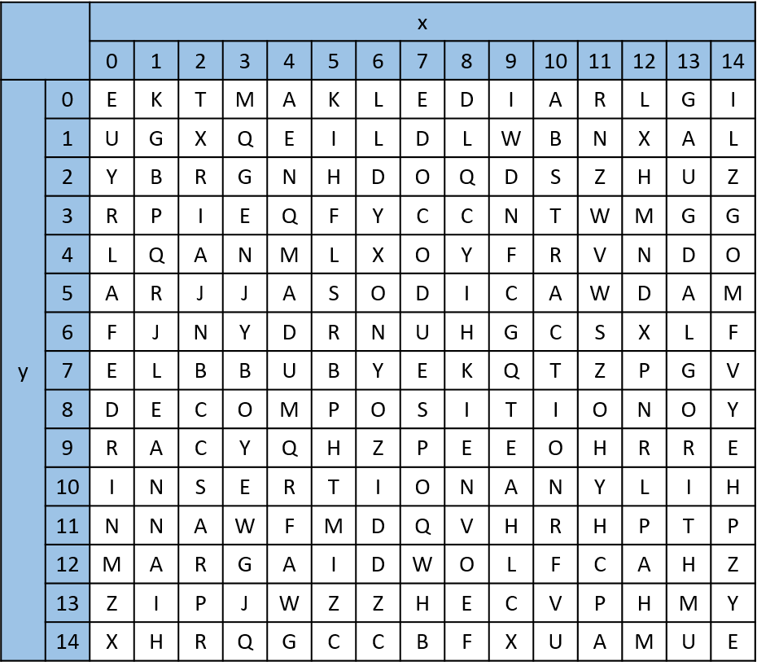
Algorithmic thinking
So, how can we store this data?
Abstraction allows us to think about what's important and what's not important.
We need to be able to:
Store the letters.
Store the location of letters in relation to all the other letters.
Refer to each letter.
Therefore, we need to number them. Simple X-Y coordinates could be helpful.

Slide 23
Algorithmic thinking
So, how can we store this data?
Abstraction allows us to think about what's important and what's not important.
We need to be able to:
Store the letters.
Store the location of letters in relation to all the other letters.
Refer to each letter.
Therefore, we need to number them. Simple X-Y coordinates could be helpful.
For example, we could refer to this instance of D as x = 7, y = 5.

Slide 24
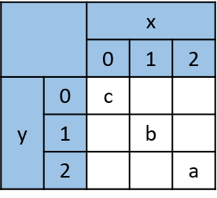
Algorithmic thinking
Abstraction also allows us to realise that:
The size of the grid is not important.
The words are not important.
The individual letters are not important.
What is important is:
The word we are currently looking for.
The letters for that word in the grid.
All the other letters are irrelevant – this allows us to simplify the grid for the purposes of programming and testing.

Slide 25
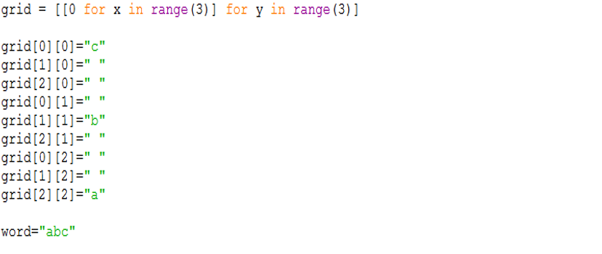
Algorithmic thinking

Slide 26
Algorithmic thinking
In Python, the grid can be represented as a list within in a list.

Slide 27
Algorithmic thinking
The word to find can be stored in a variable.

Slide 28
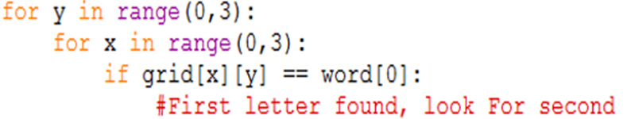
Algorithmic thinking
How can we look at every single letter in the grid in an efficient way?
Two FOR loops – one nested inside the other – allow us to look at every column and every row.
Why is a FOR loop a good choice?
We know the bounds of the grid.
They are fixed – in this example, 0 to 2.

Slide 29
Algorithmic thinking
We can make use of the fact that every letter of a string has an index:
So, we need to check if word[0] matches a letter in the grid.
We can use an IF statement to perform this check.
word = "abc"
word[0] = a
word[1] = b
word[2] = c

Slide 30
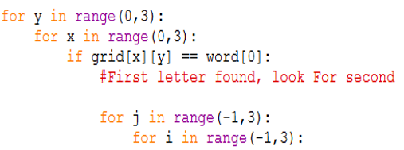
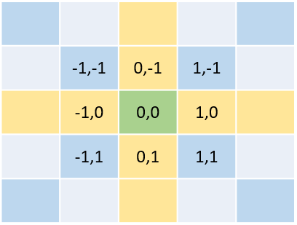
Algorithmic thinking
Once we have found the first letter, we need to expand the search to all adjacent letters.
As we are storing the letters in a list and those lists are indexed with numbers, performing this adjacent search becomes quite easy.

Slide 31
Algorithmic thinking
Once we have found the first letter, we need to expand the search to all adjacent letters.
As we are storing the letters in a list and those lists are indexed with numbers, performing this adjacent search becomes quite easy.
The adjacent letters can be referred to by their coordinates relative to the letter we are currently on.

Slide 32
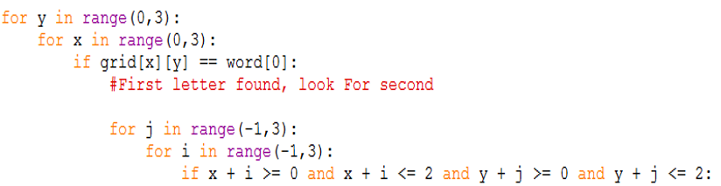
Algorithmic thinking
We must be careful that we don’t try to check cell locations beyond the edge of the grid – this would cause an error.

Slide 33
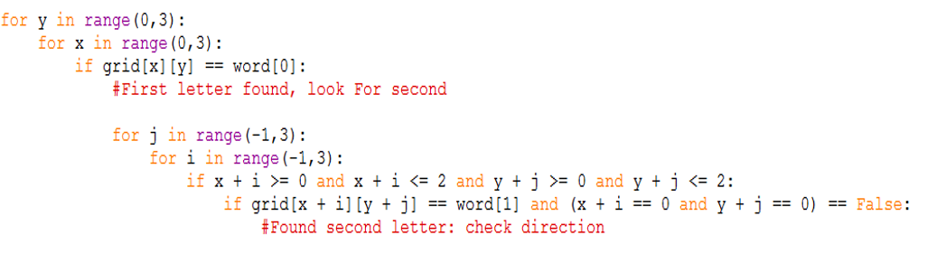
Algorithmic thinking
Now we can check if the letter in the offset position matches the second letter in the word.
Make sure not to check the original first letter while doing this.

Slide 34
Algorithmic thinking
If we find a matching letter, we need to continue checking letters in that direction up to the number of letters in the word we are looking for.

Slide 35
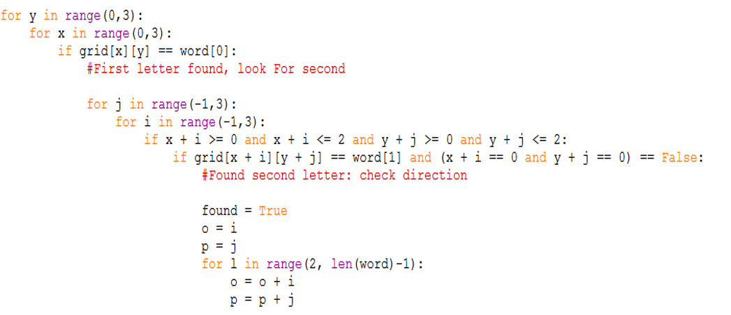
Algorithmic thinking
At this point, we only need to change one of the variables to check all the remaining letters in the word.
To do this, we introduce two other variables – o and p – which we increment in the appropriate direction.

Slide 36
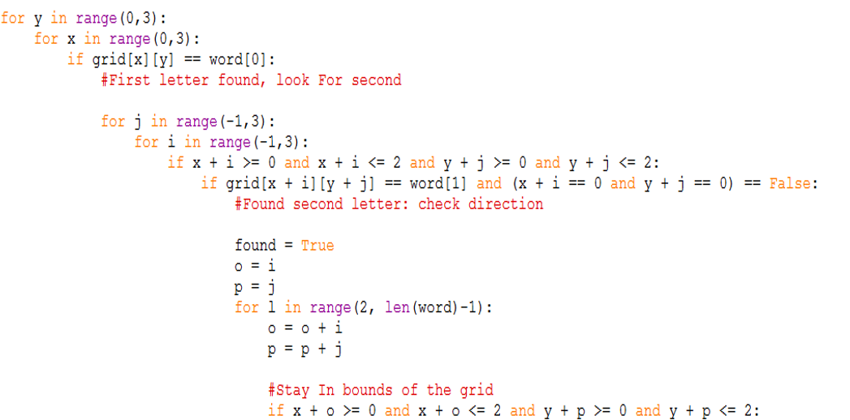
Algorithmic thinking
We check these additional letters until:
we reach the edge of the grid; or
we reach the end of the word.
Add a check to stay in the bounds of the grid.

Slide 37
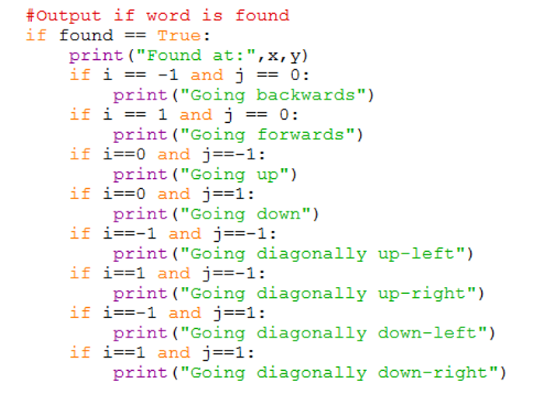
Algorithmic thinking
The final thing to code is a sensible output to the user.

Slide 38
Algorithmic thinking
The approach we have taken here could be used to tackle a range of problems.
Break the problem down.
Think about what data is important/not important.
Consider the relevant data structures.
Tackle each part of the problem step by step.
Algorithmic thinking takes practice.
The more you do it, the better you will become.

Slide 39


